Slide 1

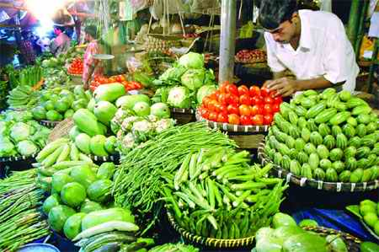

Slide 2
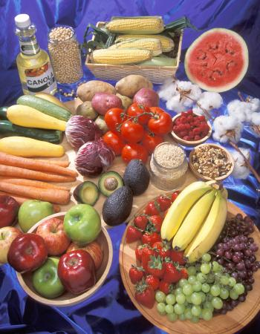
Introduction
Food biotechnology is the application of technology to modify genes of animals, plants, and microorganisms to create new species which have desired production, marketing, or nutrition related properties.
Remember… genes are sections of DNA that code for protein.

Slide 3
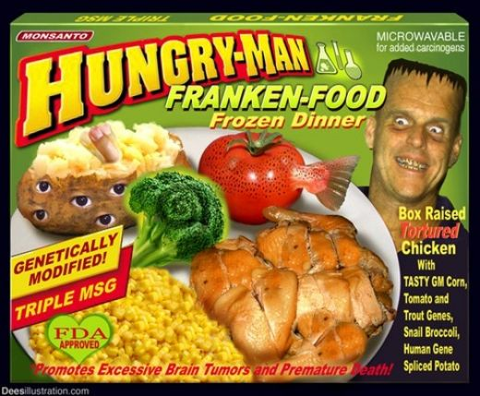
Introduction
Called genetically engineered (GE) or genetically modified (GM) foods, they are a source of an unresolved controversy over the uncertainty of their long-term effects on humans and food chains.
Nicknamed “Frankenfoods” by anti-GM food groups.

Slide 4

Why genetically modify food?
Food biotechnology is and will continue to be an important area in science as the world’s human population continues to increase and the world’s agricultural lands continue to decrease.
The following are reasons why “we” genetically modify food.

Slide 5
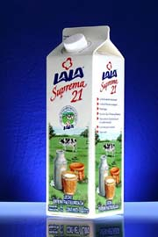
1) Extended Shelf Life
The first steps in genetic modification were for food producers to ensure larger profits by keeping food fresher, longer.
This allowed for further travel to and longer availability at markets, etc…
Extended Shelf Life Milk

Slide 6
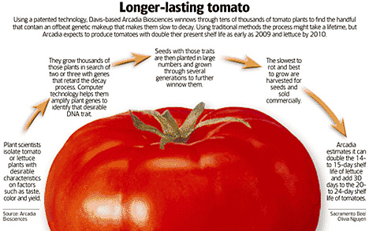
Example: Long Shelf Tomatoes
These genetically modified tomatoes promise less waste and higher profits.
Typically, tomatoes produce a protein that softens them after they have been picked.
Scientists can now introduce a gene into a tomato plant that blocks synthesis of the softening protein.
Without this protein, the genetically altered tomato softens more slowly than a regular tomato, enabling farmers to harvest it at its most flavorful and nutritious vine-ripe stage.

Slide 7
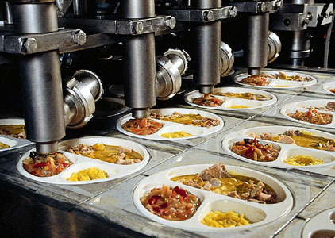
2) Efficient Food Processing
By genetically modifying food producing organisms, the wait time and quantity of certain food processing necessities are optimized.
Again this is a money saver.
Although efficient, this type of food processing is not an example of biotechnology.

Slide 8
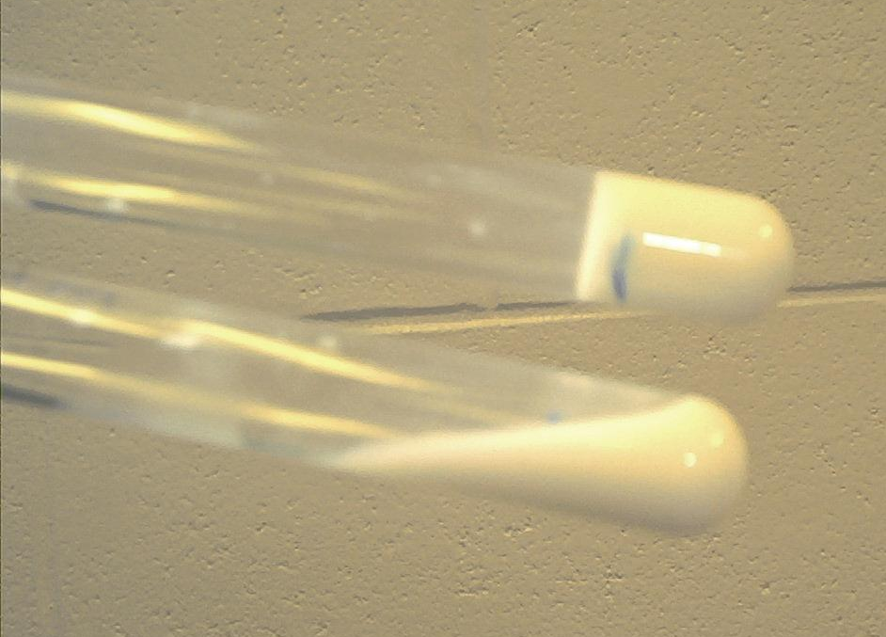
Example: Rennin Production
The protein rennin is used to coagulate milk in the production of cheese.
Rennin has traditionally been made in the stomachs of calves which is a costly process.
Now scientists can insert a copy of the rennin gene into bacteria and then use bacterial cultures to mass produce rennin.
This saves time, money, space and animals.
Rennin in the top test tube… not there in the bottom one.
Notes:
Also working on producing lactose-free or low lactose milk (have done this in mice, but not in cows yet)… also possibly looking at caffeine free coffee beans.

Slide 9
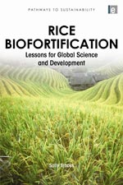
3) Better Nutrient Composition
Some plants, during processing, lose some of the vital nutrients they once possessed.
Others are grown in nutrient poor areas.
Both these problems can be solved by introducing genes into plants to increase the amount or potency of nutrients.
“Biofortification”

Slide 10
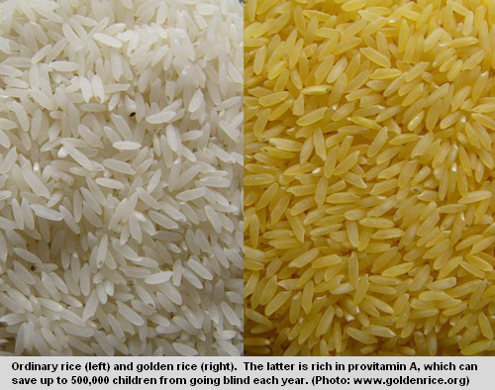
Example: Golden Rice
Scientists have engineered "golden rice", which has received genes from a daffodil and a bacterium that enable it to make beta-carotene.
This offers some promise in helping to correct a worldwide Vitamin A deficiency.

Slide 11
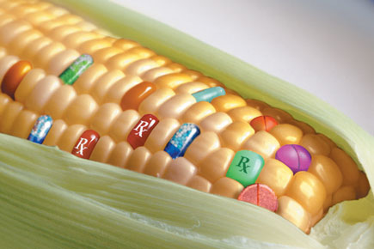
4) Efficient Drug Delivery
Inserting genes into plants/animals to produce essential medicine or vaccines.
“Biopharming”

Slide 12
Many Unpatented Examples
A cow with the genetic equipment to make a vaccine in its milk could provide both nourishment and immunization to a whole village of people now left unprotected because they lack food and medical help (in progress).
Bananas and potatoes make hepatitis vaccines (done).
Making AIDS drugs from tobacco leaves (done).
Harvest vaccines by genetically altering hydroponically grown tomato plants to secrete protein through their root systems into the water (done).

Slide 13
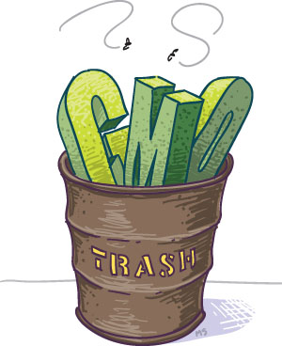
Potential Problems???
With every technology there is an associated risk involved.
The following are some examples of potential problems associated with food biotechnology.

Slide 14
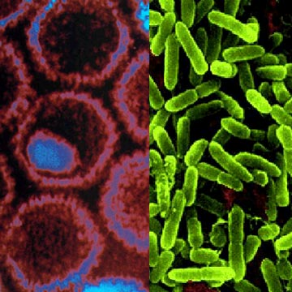
1) Creating “Superbugs”
Since many of the “vectors” used to introduce genes to plants and animals are bacteria and viruses, it is realistic to think there is a chance they could undergo a mutation and prove harmful or become recombinant like the H1N1 virus and thus more virulent.
However, the bacteria and viruses used in these procedures are usually non-pathogenic.
Viruses Bacteria

Slide 15
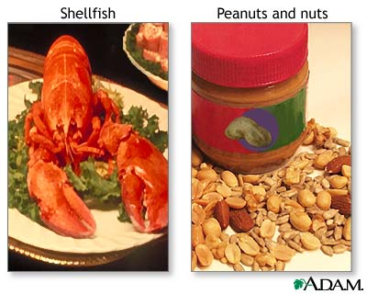
2) Negative Affects on Human Health
Most of these food products undergo testing to see if any adverse health effects occur.
However, allergies were not thought of in one case where a gene from a brazil nut was transferred to soy bean plants!
Thankfully a food product was not pursued as someone came to their senses!
Important to note that not all genes from a potential allergenic food will cause an allergy.

Slide 16

3) Ethics
How many human genes would an organism have to have before you consider it human???
The following food types have a variety with human genes added: rice (immune system genes that prevent diarrhea), baby food (lactoferrin and lysozyme) and any farm animal (Human growth hormone).
Notes:
Lysozyme destroys bacterial cell walls and lactoferrin is an iron binding protein that also fights off viruses and bacteria.

Slide 17
Homework
What is the best reason for genetically modifying food?
What is a potential problem that you feel should be studied further before advancing farther into food biotechnology?
What food item would you genetically engineer? Why? For what purpose? What genes would you transfer?

